Slide 1

Evaluation Metrics

Slide 2
Overview
Need for model evaluation
Evaluation Metrics for Prediction(Regression) models
Evaluation Metrics for Classification models
Asymmetrical Costs of (mis)classification
Alternate Evaluation Measures for Classification models

Slide 3
Why do we need to evaluate models?
Multiple ML algorithms applicable to classification/prediction
Wide choice of parameter and/or hyperparameter settings possible in these algorithms
Hence the need to evaluate each model’s performance
In all cases, performance to be evaluated on validation/test data (to avoid wrong interpretations from overfitting on training data)

Slide 4





Evaluating performance in Prediction
In such scenarios, we need to evaluate how the model predicts new data, not how well it fits the data it was trained with (goodness-of-fit)
Key component of most performance measures is the difference between actual y and predicted y' which is referred to as the ‘error’ :
Error Measure | Formulae
Mean Absolute Error (MAE)
Mean Percentage Error (MPE)
Mean Absolute Percentage Error
Sum of Squared Errors (SSE)
Root Mean Squared Error (RMSE)
e = 𝑦 - y'
Notes:
Here's a brief explanation of RMSE:
Calculate the error for each data point: For each data point, find the difference between the predicted value and the actual (observed) value.
Square the errors: To account for both overestimation and underestimation, square each of the individual errors.
Calculate the mean of the squared errors: Find the average of the squared errors.
Take the square root of the mean: Finally, to bring the error metric back to the original scale, take the square root of the average squared error.
The RMSE provides a measure of the "typical" or "root" error between the predicted and actual values. It tells you how far, on average, your predictions are from the actual values. A smaller RMSE indicates that the predictions are closer to the actual values and, therefore, a more accurate model.
RMSE is commonly used in various fields, including machine learning, statistics, and engineering, to assess the performance of regression models and to compare the accuracy of different models or techniques.

Slide 5
Evaluating performance in Classification
Most Classification algorithms classify via a 2-step process:
For each record,
Compute probability of belonging to class ‘1’
Compare to cutoff value, and classify accordingly
(Default cutoff value is 0.50, If >= 0.50, classify as “1”, If < 0.50, classify as “0”)
Can use different cutoff values and accordingly the classification output varies
Error = classifying a record as belonging to one class when it actually belongs to another class.
Error rate = percent of misclassified records out of the total records in the validation/test data

Slide 6

Confusion Matrix
Actual Class
C₁
C₂
n _{1, 1} = number of C₁ records classified correctly as C₁ | n _{2, 1} = number of C₂ records classified incorrectly as C₁
n _{1, 2} = number of C₁ records classified incorrectly as C₂ | n _{2, 2} = number of C₂ records classified correctly as C₂
C
1
Predicted Class
C₂

Slide 7
When One Class is More Important & misclassification costs are asymmetrical
In most cases it is more important to identify members of one class
Diagnosing illness (Illness)
Detecting SPAM mail (Spam mails)
Credit default (Potential Defaulter Class)
Tax fraud (Fraudulent Tax Class)
Response to promotional offer (Respondent Class)
Detecting electronic network intrusion (Malicious Packet class)
Predicting delayed flights (Delayed flights)
In such cases, we are willing to tolerate greater overall error, in return for better identifying the important class for further attention
The cost of making a misclassification error may be higher for one class than the other(s)

Slide 8
Asymmetrical Costs – Response to Promotional Offer
Suppose we send an offer to 1000 people, with 1% average response rate (“1” = response, “0” = nonresponse)
“Naïve rule” (classify everyone as ‘0') has error rate of 1%
(seems good)
Let’s assume that by using some ML model
We can correctly classify eight 1’s as 1’s
It comes at the cost of misclassifying twenty 0’s as 1’s and two 1’s as 0’s.
Error rate = (2+20) = 2.2% (higher than naïve rate)
Suppose: Profit from a ‘1’ is $10 & Cost of sending offer is $1
Under naïve rule, all are classified as “0”, so no offers are sent:
no cost, no profit
Under ML predictions, 28 offers are sent. 8 respond with profit of $10 each 20 fail to respond, cost $1 each
972 receive nothing (no cost, no profit)
Net profit = $60
Thus, we need to look beyond the traditional error/accuracy metrics in classification scenarios
 | Actual 1 | Actual 0
Predicted 1 | 8 | 20
Predicted 0 | 2 | 970
 | Actual 1 | Actual 0
Predicted 1 | 80$ | -20$
Predicted 0 | 0 | 0

Slide 9
Basic terms
True positives (TP): Predicted positive and are actually positive.
False positives (FP): Predicted positive and are actually negative.
True negatives (TN): Predicted negative and are actually negative.
False negatives (FN): Predicted negative and are actually positive.

Slide 10
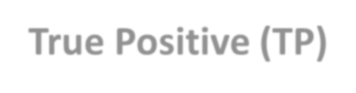
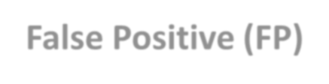
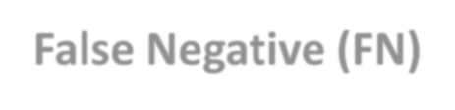
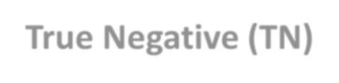
Alternate Accuracy Measures
Actual Class
C₁ C₂
If “C₁” is the important class,
Sensitivity (also called “recall) = %
n _{1, 1} = number of C₁ records classified correctly as C₁ True Positive (TP) | n _{2, 1} = number of C₂ records classified incorrectly as C₁ False Positive (FP)
n _{1, 2} = number of C₁ records classified incorrectly as C₂ False Negative (FN) | n _{2, 2} = number of C₂ records classified correctly as C₂ True Negative (TN)
of actual C class correctly classified
C₁
1
^{n} 1, 1 ^{/ (n} 1, 1
+ n )
1, 2
Predicted
Class
Ability of the classifier to detect the important class members correctly.
C₂
Also referred to as True Positive Rate, TPR = TP/ (TP + FN)

Slide 11
Alternate Accuracy Measures
Actual Class
C₁ C₂
If “C₁” is the important class,
Specificity = % of actual C₂ class correctly classified
n _{1, 1} = number of C₁ records classified correctly as C₁ True Positive (TP) | n _{2, 1} = number of C₂ records classified incorrectly as C₁ False Positive (FP)
n _{1, 2} = number of C₁ records classified incorrectly as C₂ False Negative (FN) | n _{2, 2} = number of C₂ records classified correctly as C₂ True Negative (TN)
C₁
^{n} 2, 2 ^{/ (n} 2, 1
+ n )
2, 2
Predicted
Class
Ability of the classifier to rule out the other class members (C₂) correctly.
Also referred to as True Negative Rate, TNR = TN / (FP + TN)
C₂
False Positive Rate (FPR) = 1- Specificity
FPR = FP / (FP + TN)

Slide 12
Alternate Accuracy Measures
Actual Class
If “C₁” is the important class,
C₁ C₂
Precision= % of predicted C that are
n _{1, 1} = number of C₁ records classified correctly as C₁ True Positive (TP) | n _{2, 1} = number of C₂ records classified incorrectly as C₁ False Positive (FP)
n _{1, 2} = number of C₁ records classified incorrectly as C₂ False Negative (FN) | n _{2, 2} = number of C₂ records classified correctly as C₂ True Negative (TN)
actually C₁
^{n} 1, 1 ^{/ (n} 1, 1 ^{+ n} 2, 1⁾
TP/ (TP + FP)
1
C₁
Recall (also called “sensitivity”) = % of actual
C₁ class correctly classified
^{n} 1, 1 ^{/ (n} 1, 1 ^{+ n} 1, 2⁾
TP/ (TP + FN)
Predicted
Class
F-Measure provides a way to combine both precision and recall into a single measure that captures both properties. Also know as F-Score or F1-Score
F1-Score= (2*Precision*Recall) /(Precision + Recall)
Common metric used on classification problems on imbalanced datasets.
C₂

Slide 13
Example 1: Binary classification
We have 2 types of fruits apples and grapes and we want our machine learning model to identify or classify the given fruit as an apple or a grape.
Total no. of samples = 15, no. of apples = 8 and no. of grapes = 7
We will represent apple as 1 and grape as 0 class.
Suppose,
Actual = [1,1,1,1,1,1,1,1,0,0,0,0,0,0,0]
Prediction = [1,0,0,0,1,1,1,1,0,0,0,0,0,1,1]
Then,
TP=5, FN=3, FP=2, TN=5

Slide 14
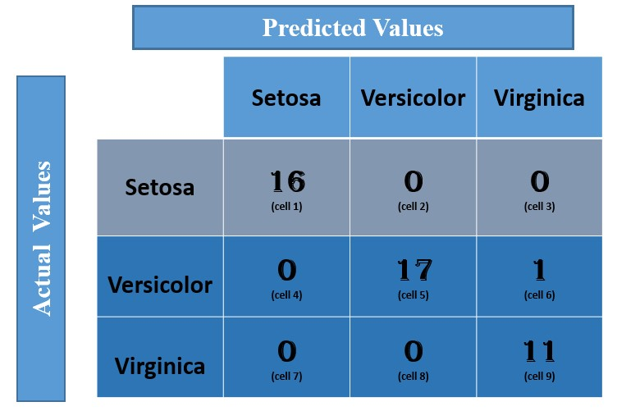
Example 2: Multi-class classification – IRIS DATASET.
In the multi-class classification problem, we won’t get TP, TN, FP, FN values directly as in the binary classification problem. We need to calculate for each class.
The dataset has 3 flowers
as outputs or classes,
Versicolor
Virginica
Setosa

Slide 15
Let us calculate the TP, TN, FP, FN values for the class Setosa
TP: The actual value and predicted value should be the same. So concerning Setosa class, the value of cell 1 is the TP value.
FN: The sum of values of corresponding rows except the TP value.
FN = (cell 2 + cell3) = (0 + 0) = 0
FP : The sum of values of corresponding column except the TP value.
FP = (cell 4 + cell 7) = (0 + 0) = 0
TN: The sum of values of all columns and row except the values of that class that we are calculating the values for.
TN = (cell 5 + cell 6 + cell 8 + cell 9) = 17 + 1 +0 + 11 = 29

Slide 16
Now, let us calculate the TP, TN, FP, FN values for the class Versicolor
TP: The actual value and predicted value should be the same. So
TP = 17 (cell 5)
FN: The sum of values of corresponding rows except the TP value.
FN = (cell 4 + cell 6) = 0 + 1 = 1
FP: The sum of values of corresponding column except the TP value.
FP = (cell 2 + cell 8) = 0 + 0 = 0
TN: The sum of values of all columns and row except the values of that class that we are calculating the values for.
TN = (cell 1 + cell 3 + cell 7 + cell 9) = 16 + 0 + 0 + 11 = 27

Slide 17
Similarly we can calculate the TP, TN, FP, FN values for the class Virginica
TP: The actual value and predicted value should be the same. So
TP = 11 (cell 9)
FN: The sum of values of corresponding rows except the TP value.
FN = (cell 7 + cell 8) = (0 + 0) = 0
FP: The sum of values of corresponding column except the TP value.
FP = (cell 3 + cell 6) = (0 + 1) = 1
TN: The sum of values of all columns and row except the values of that class that we are calculating the values for.
TN = (cell 1 + cell 2 + cell 4 + cell 5) = 16 + 0 +0 + 17 = 33

Slide 18
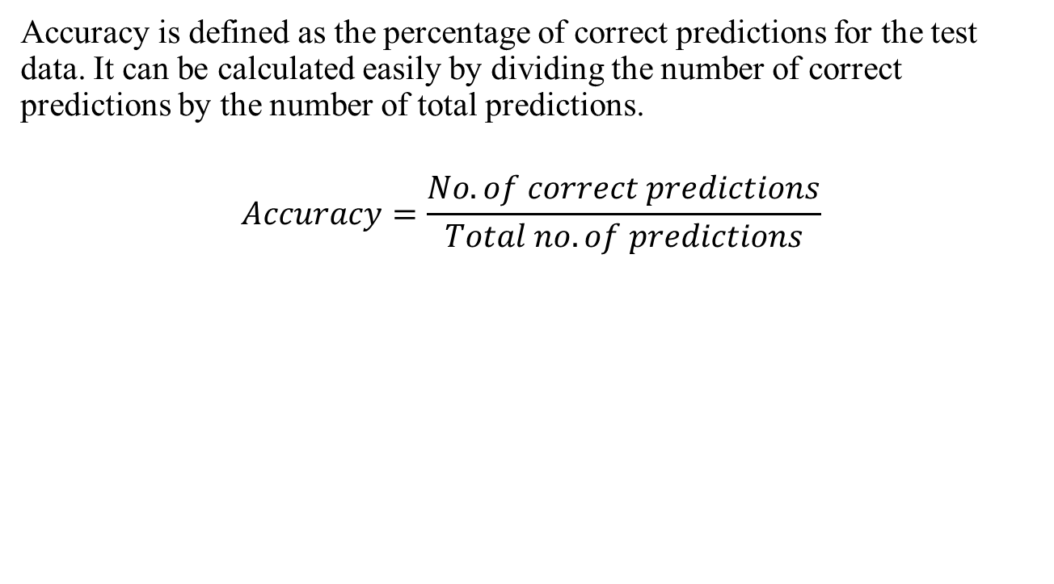
Accuracy

Slide 19
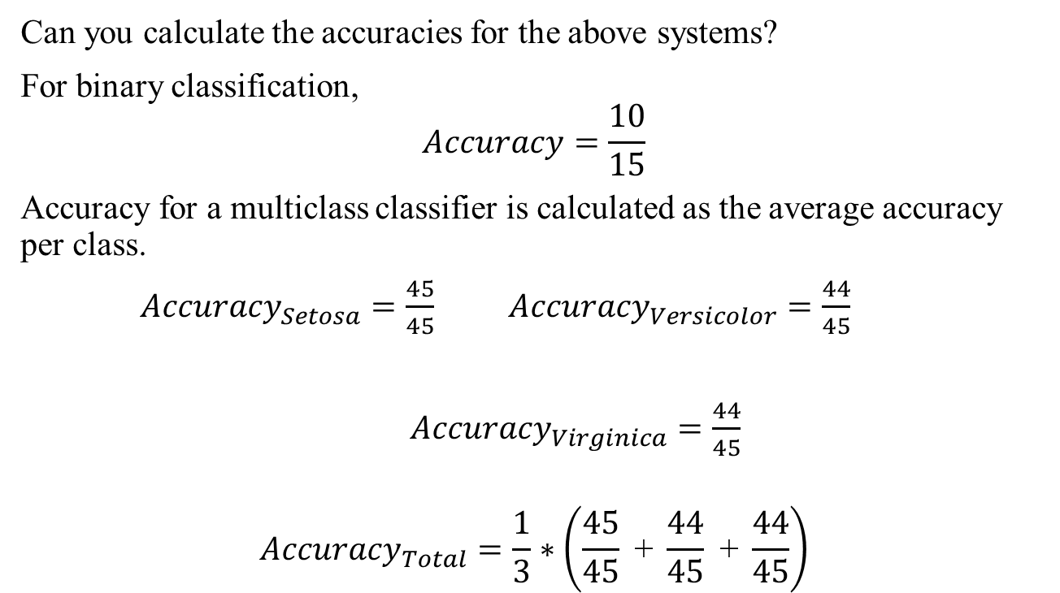
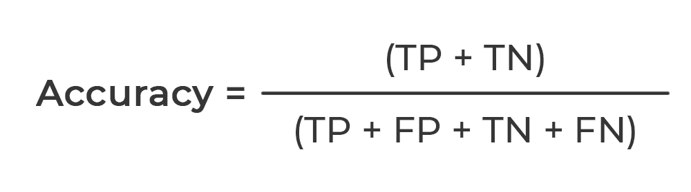

Slide 20
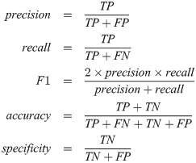
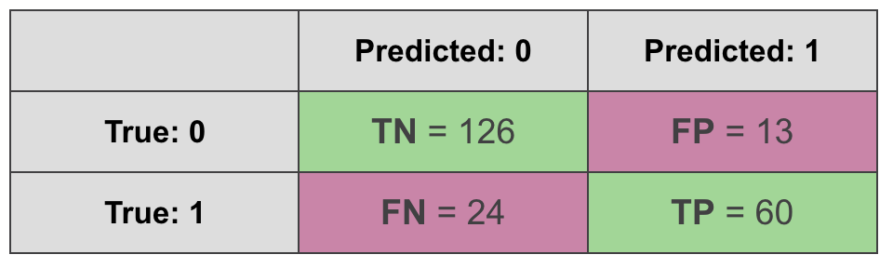
Performance evaluation
20
Evaluate the performance of a binary classifier from the below confusion matrix using Accuracy, Precision, Recall, Specificity and F1 Score.

Slide 21
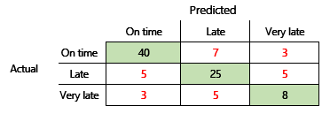
21
Performance evaluation
Evaluate the performance of a multiclass classifier from the below confusion matrix using Accuracy, Precision, Recall, Specificity and F1 Score.

Slide 22
Suppose 10,000 patients get tested for cancer; out of them, 8,200 are healthy and 1,800 are sick. For the sick people, a test was positive for 1,020 and negative for 780. For the healthy people, the same test was positive for 280 and negative for 7,920. Construct a confusion matrix for the data. Compute the precision, recall and F1 score.

Slide 23
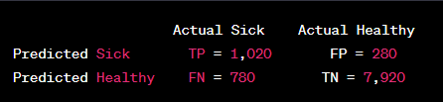
Solution
Here's how you can construct the confusion matrix based on the given data: -
True Positive (TP): The number of sick people correctly identified as sick.
False Positive (FP): The number of healthy people incorrectly identified as sick.
True Negative (TN): The number of healthy people correctly identified as healthy.
False Negative (FN): The number of sick people incorrectly identified as healthy.
From the given data:
TP = 1,020 (sick people correctly identified as sick)
FP = 280 (healthy people incorrectly identified as sick)
TN = 7,920 (healthy people correctly identified as healthy)
FN = 780 (sick people incorrectly identified as healthy)
Now, let's construct the confusion matrix:

Slide 24
Now, you can calculate precision, recall, and F1 score:
1. Precision (also called Positive Predictive Value):
Precision = TP / (TP + FP)
Precision = 1,020 / (1,020 + 280)
Precision = 1,020 / 1,300
Precision = 0.7846
2.Recall (also called Sensitivity or True Positive Rate):
Recall = TP / (TP + FN)
Recall = 1,020 / (1,020 + 780)
Recall = 1,020 / 1,800
Recall = 0.5667
3. F1 Score: F1 Score is the harmonic mean of precision and recall.
F1 Score = 2 * (Precision * Recall) / (Precision + Recall)
F1 Score = 2 * (0.7846 * 0.5667) / (0.7846 + 0.5667)
F1 Score ≈ 0.6617
So, the precision is approximately 0.7846, the recall is approximately 0.5667, and the F1 score is approximately 0.6617.

Slide 25
Summary
Evaluation metrics are important for comparing across different ML models, for choosing the right configuration of a specific ML model
Metrics are computed from validation/test data
Preferred metrics for evaluating regression(prediction) : RMSE
Confusion Matrix forms the basis for evaluation in classification scenarios
Asymmetric Costs of Mis-classification and need to go beyond error rate
Metrics for evaluation in Classification generated from Confusion Matrix: Sensitivity, Specificity, Precision, Recall, F1 Score, etc.

Slide 26
References
https://www.analyticsvidhya.com/blog/2019/08/11-important-model- evaluation-error-metrics/
https://medium.com/analytics-vidhya/complete-guide-to-machine- learning-evaluation-metrics-615c2864d916
https://python-data-science.readthedocs.io/en/latest/evaluation.html

Slide 27
Overview
Receiver Operating Characteristic (ROC) Curves
Precision Recall (PR) Curves
Comparing models using ROC AUC / PR AUC

Slide 28
Alternate Accuracy Measures
If “C₁” is the important class,
Sensitivity (also called “recall) = % of actual C₁ class correctly classified
n _{1, 1} / (n _{1, 1} + n _{1, 2})
True Positive Rate, TPR = TP/ (TP + FN)
Specificity = % of actual C₂ class correctly classified
n _{2, 2} / (n _{2, 1} + n _{2, 2})
True Negative Rate, TNR = TN / (FP + TN)
False Positive Rate (FPR) = 1- Specificity
FPR = FP / (FP + TN)
Actual Class
C₁
C₂
n _{1, 1} = number of C₁ records classified correctly as C₁
n _{2, 1} = number of C₂ records classified incorrectly as C₁
C₁
True Positive (TP)
False Positive (FP)
Predicted
Class
n _{1, 2} = number of C₁ records classified incorrectly as C₂
n _{2, 2} = number of C₂ records classified correctly as C₂
C₂
False Negative (FN)
True Negative (TN)

Slide 29
ROC Curves (Receiver Operating Characteristic Curves) for a Perfect Classifier
When threshold is near 1,
Sensitivity = TP/(TP+FN) = 0/10 = 0
Specificity = TN/(TN+FP) = 10/10= 1
Hence (0,0)
1.00
Threshold
Genuine Mail (10)
SPAM Mail (10)
(0,1)
(0.5,1)
(1,1)
1.00
Actual
0.80
Gen
SPAM
When threshold is near .75,
Sensitivity = TP/(TP+FN) = 5/10 = 0.5
Specificity = TN/(TN+FP) = 10/10= 1
Hence (0,0.5)
Gen
TP=0
FP=0
Pred
SPAM
FN=10
TN=10
0.75
Actual
SPAM
0.60
Gen
Gen
TP=5
FP=0
Pred
Sensitivity (TPR)
When threshold is near 0.5,
Sensitivity = TP/(TP+FN) = 10/10 = 1
Specificity = TN/(TN+FP) = 10/10= 1
Hence (0,1)
SPAM
FN= 5
TN=10
(0,0.5)
0.50
Actual
0.40
Gen
SPAM
Gen
TP=10
FP=0
Pred
SPAM
FN=0
TN=10
When threshold is near 0.25,
Sensitivity = TP/(TP+FN) = 10/10 = 1
Specificity = TN/(TN+FP) = 5/ 10 = 0.5
Hence (0.5,1)
0.25
Actual
0.20
Gen
SPAM
Gen
TP= 10
FP=5
Pred
SPAM
FN= 0
TN=5
(0,0)
0.00
Actual
SPAM
0.00
When threshold is near 0.0,
Sensitivity = TP/(TP+FN) = 10/10 = 1
Specificity = TN/(TN+FP)= 0/10 = 0
Hence (1,1)
Gen
Gen
TP = 10
FP = 10
0.20
0.40
0.60
0.80
1.00
Pred
SPAM
FN= 0
TN= 0
1 – Specificity (FPR)

Slide 30
ROC Curves (Receiver Operating Characteristic Curves) for a Perfect Classifier
ROC curve is an evaluation metric for binary classification problems.
Plots the Sensitivity (TPR) against 1 – Specificity (FPR) for varying threshold values
Area Under the Curve (AUC) is the measure of the ability of a classifier to distinguish between classes and is used as a summary of the ROC curve
The goal in ROC space is to be in the upper-left-hand corner (0, 1), i.e. zero FP’s (FPR=0) ; Sensitivity(Recall)=1, i.e. all the positives classified as positives
The diagonal (the “curve” for a naïve classifier), on an average, when drawing randomly scores on the unit interval or if our predictions are all 0 or all 1.
1.00
Threshold
Genuine Mail (10)
SPAM Mail (10)
(0,1)
(0.5,1)
(1,1)
1.00
0.80
0.75
0.60
Sensitivity (TPR)
(0,0.5)
0.50
0.40
0.25
0.20
(0,0)
0.00
0.00
0.20
0.40
0.60
0.80
1.00
1 – Specificity (FPR)

Slide 31
Precision Recall Curves for a Perfect Classifier
Performance of the positive class (minority) when dealing with imbalanced classes.
We are less interested in the skill of the model at predicting class 0 correctly, e.g. high true negatives. Key to the calculation of precision and recall is that the calculations do not make use of the true negatives. It is only concerned with the correct prediction of the minority class
In the PR space, the goal is to be in the upper-right-hand corner — the top right corner (1, 1), all positives are classified as positive (Recall=1) and everything we are classifying as positive is true positive (Precision=1), ie zero False Positives.
1.00
Threshold
Genuine Mail (10)
SPAM Mail (10)
(0,1)
(0.5,1)
(1,1)
1.00
0.80
0.75
0.60
Precision
(0,0.5)
0.50
0.40
‘No Model’ Baseline obtained by P/(P+N), where the classifier always predicts the minority class, i.e. positive.
0.25
0.20
(0,0)
0.00
0.00
0.20
0.40
0.60
0.80
1.00
Recall (Sensitivity)

Slide 32
ROC Curve for Imperfect classifier
By design the ROC curve typically develops in a U-shape
Step Left: Turn a False Positive (blue cross) into a True Negative (blue dot). This behavior represents a correct decision and thus it reduces the False Positive Rate (x-axis) (mostly from -1.5 to -0.5)
Step downwards: Turn a True Positive (orange dot) into a False Negative (orange cross). This behavior represents a wrong decision and thus it reduces the Recall (y-axis). (mostly from 0.5 to 1.5)
Image Source: https://towardsdatascience.com/on-roc-and-precision-recall-curves-c23e9b63820c

Slide 33
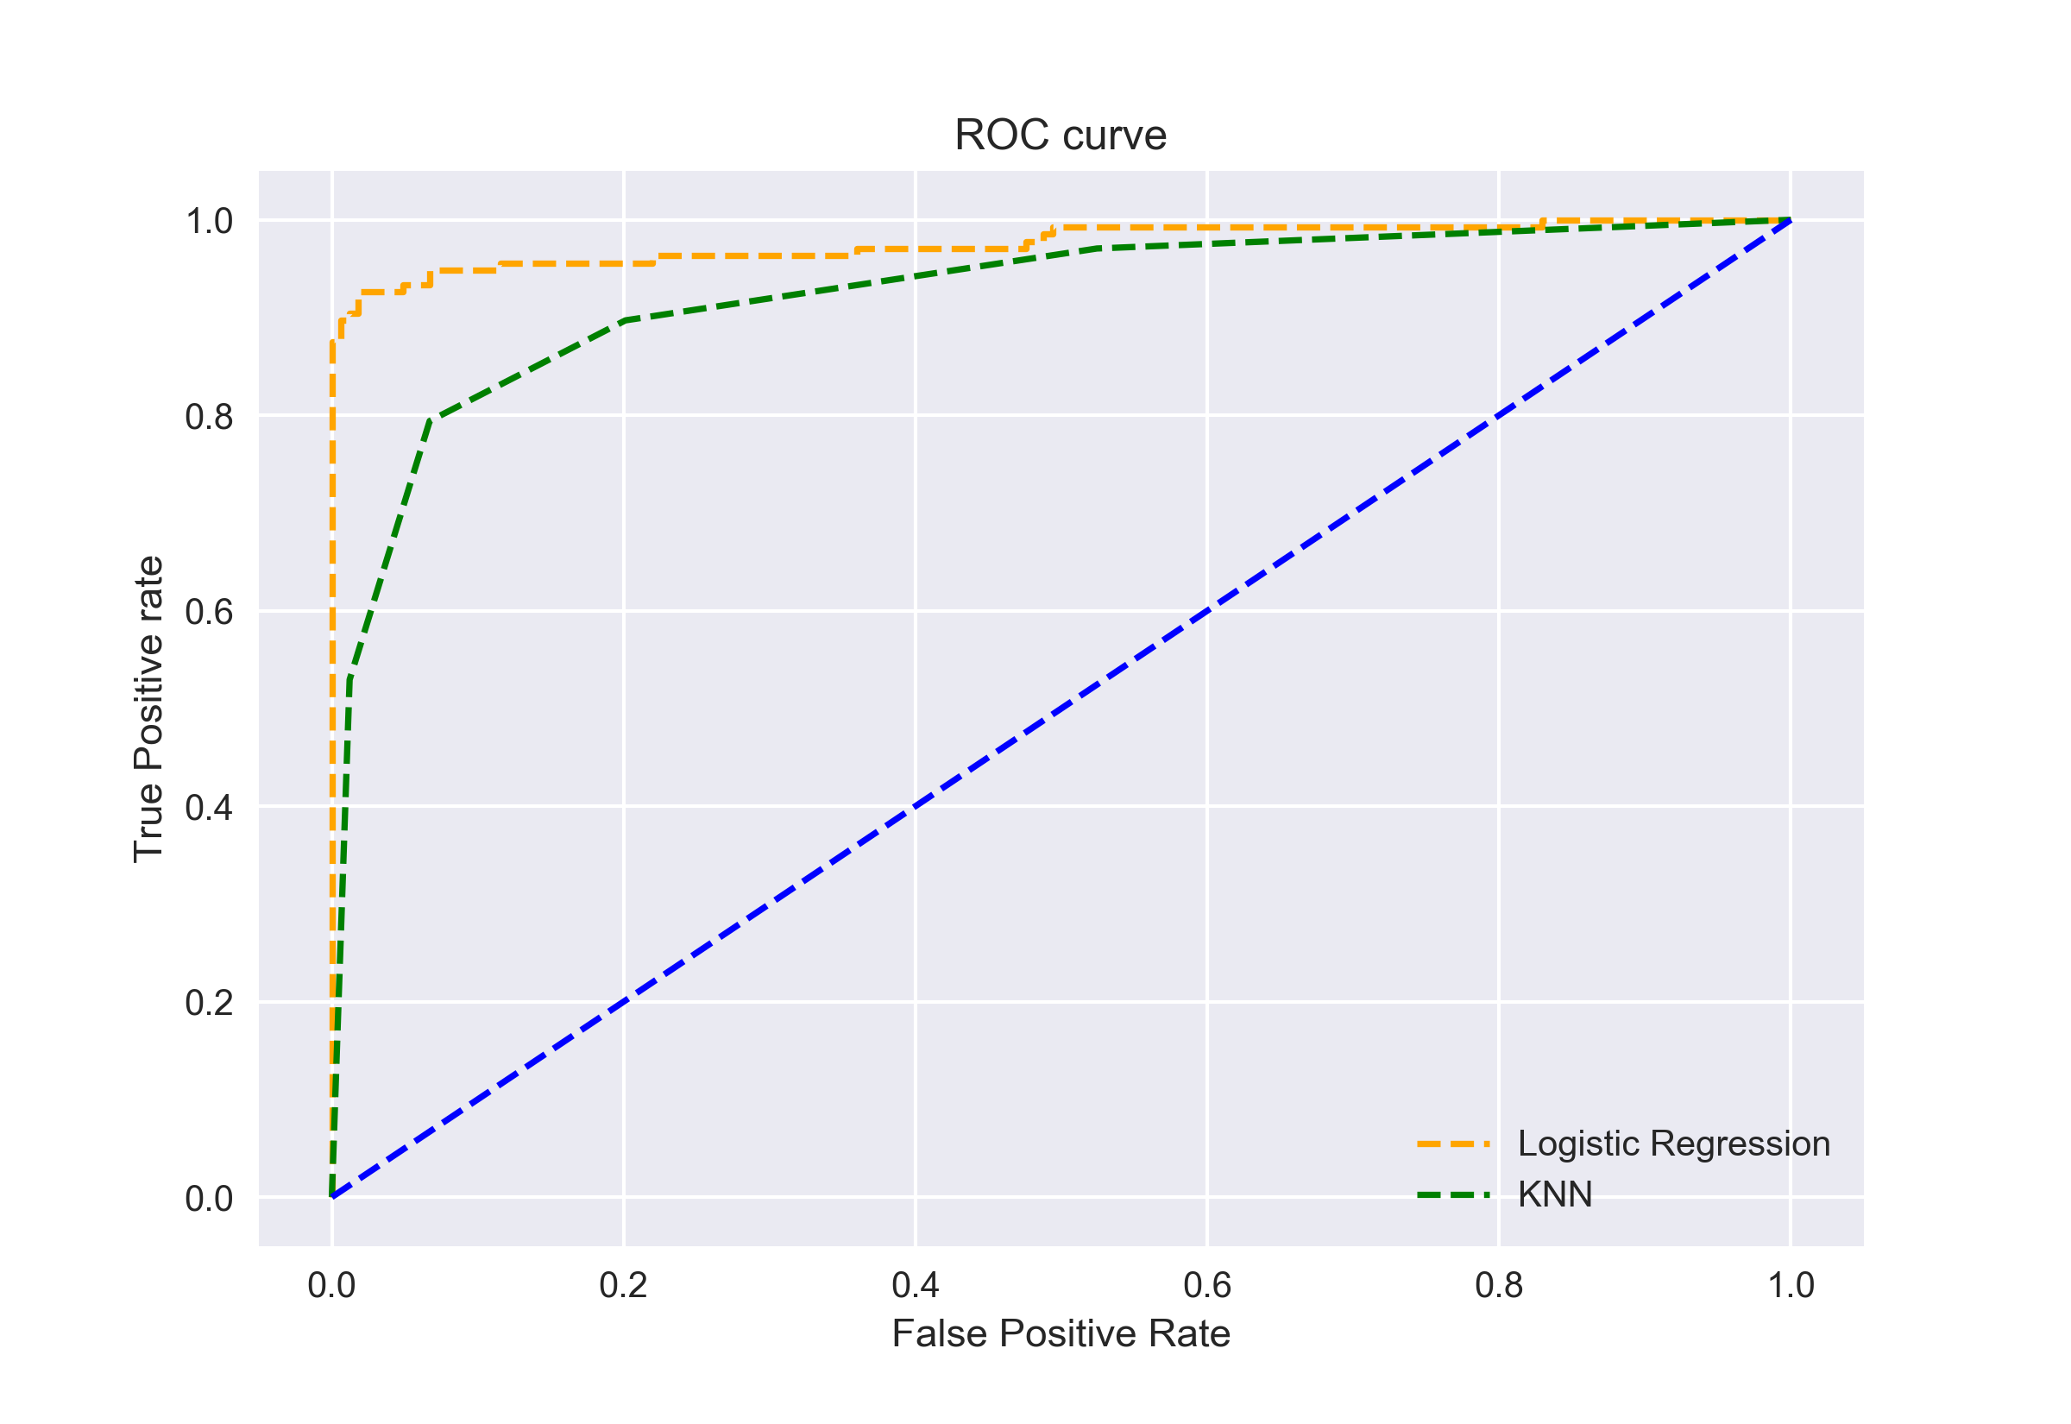
ROC curves for comparing models – Area Under the Curve
The curves of different models can be compared directly in general or for different thresholds.
As it can be challenging to compare two or more classifiers based on their curves, the Area Under the Curve (AUC) can be used as a summary of the model skill
AUC for the Logistic Regression ROC curve is higher than that for the KNN ROC curve.
Here Logistic regression performs better in classifying the positive class in this dataset
PR AUC can be used for compare classification models on imbalanced datasets
Image Source: https://www.analyticsvidhya.com/blog/2020/06/auc-roc-curve-machine-learning/

Slide 34
Summary
ROC curve is an evaluation metric for binary classification problems.
ROC plots the Sensitivity (TPR) against 1 – Specificity (FPR) for varying threshold values
The goal in ROC space is to be in the upper-left-hand corner
ROC AUC used to compare across different classification models
PR Curve is used to assess the performance of the model on positive class (minority) when dealing with imbalanced classes.
PR AUC used to compare classification models on imbalanced datasets

Slide 35
References
https://www.analyticsvidhya.com/blog/2020/06/auc-roc-curve-machine-learning/
https://towardsdatascience.com/on-roc-and-precision-recall-curves-c23e9b63820c
https://machinelearningmastery.com/roc-curves-and-precision-recall-curves-for-classification-in-python/
https://machinelearningmastery.com/roc-curves-and-precision-recall-curves-for-imbalanced-classification/

